Slide 1


DEPARTMENT OF COMPUTER SCIENCE AND ENGINEERING
Nutritionist Generative AI Doctor using Gemini
Ms. M Anitha, M.E., (Ph.D.)
Assistant Professor,
Department of Computer Science and Engineering,
Rajalakshmi Engineering College,
Thandalam.
Kamalesh S P – 230701138
Mathan Kumar M - 230701181

Slide 2
ABSTRACT
The "Nutritionist Generative AI Doctor" an advanced tool designed to simplify nutritional tracking and promote healthier dietary habits. By leveraging the multimodal capabilities of Google's Gemini AI/with Clarifai model, the system analyzes user-uploaded images of meals to provide an instant, detailed breakdown of their nutritional content. The AI identifies food items, estimates total calories, and quantifies macronutrient and micronutrient distributions. The primary goal is to offer an accessible, user-friendly solution for individuals, fitness enthusiasts, and nutritionists to monitor dietary intake, make informed food choices, and achieve health and wellness targets effortlessly.

Slide 3
INTRODUCTION
In today's fast-paced world, manually tracking dietary intake is often tedious, inaccurate, and time-consuming. While numerous apps exist, they typically require manual data entry, which can be a significant barrier for consistent use.
The Nutritionist Generative AI Doctor addresses this challenge by automating the process. Users simply take a picture of their meal, and the AI handles the rest. This innovative approach removes the friction from calorie counting and nutritional analysis, making it accessible to everyone from beginners to health experts. The project aims to bridge the gap between technology and personal health, empowering users to understand and improve their eating habits with ease.

Slide 4
OBJECTIVES
To Develop an Automated System: Create a tool that automatically identifies food items from an image.
To Provide Detailed Nutritional Analysis: Extract and calculate key nutritional data, including total calories, carbohydrates, proteins, and fats.
To Assess Meal Quality: Evaluate the overall healthiness of a meal and provide a simple, understandable assessment.
To Offer Actionable Recommendations: Generate personalized diet suggestions for improvement based on the meal analysis.
To Ensure User-Friendliness: Design a seamless and intuitive user experience that requires minimal effort from the user.

Slide 5
LITERATURE REVIEW
S.No | Author(s) & Year | Title of Paper | Methodology / Approach | Key Findings / Contribution | Relevance to Current Project
1 | Zhou et al., 2021 | Food Recognition Using Deep CNNs | Developed a deep convolutional neural network (CNN) model trained on large-scale food image datasets to identify meal categories. | Achieved high accuracy in recognizing multiple food items within a single image by using feature extraction and image segmentation layers. | Provides the foundation for food detection in your project’s image analysis pipeline before calorie estimation.
2 | Mekhmoukh et al., 2022 | AI in Personalized Nutrition | Used machine learning algorithms to tailor diet recommendations based on user profiles, age, weight, and activity level. | AI models significantly improve personalization in dietary planning and health outcomes. | Supports your system’s personalized nutrition suggestions after Gemini analysis.

Slide 6
LITERATURE REVIEW
S.No | Author(s) & Year | Title of Paper | Methodology / Approach | Key Findings / Contribution | Relevance to Current Project
3 | Singh et al., 2023 | Nutrient Estimation with Computer Vision | Combined object detection with nutritional databases to map food images to their macro and micronutrient values. | Improved precision in estimating calorie content by linking vision outputs to nutrient datasets. | Aligns with your nutrient breakdown and calorie estimation step using Gemini outputs.
4 | Lee et al., 2023 | Deep-Learning Calorie Estimator | Developed a CNN model trained with annotated images to estimate calorie content based on portion size and type of meal. | Enhanced calorie estimation by integrating depth data and image segmentation. | Inspires the calorie computation mechanism in your project’s analytical workflow.

Slide 7
LITERATURE REVIEW
S.No | Author(s) & Year | Title of Paper | Methodology / Approach | Key Findings / Contribution | Relevance to Current Project
5 | Chen et al., 2024 | Multimodal AI for Food Analysis | Integrated text, image, and sensor data in a multimodal AI framework for comprehensive food recognition. | Multimodal systems outperform image-only models by combining visual and contextual information. | Demonstrates the potential of Google Gemini’s multimodal capability, the core engine of your project.
6 | Ahmad et al., 2020 | Food Image Segmentation for Calorie Prediction | Used semantic segmentation to isolate food items and calculate caloric content through volume estimation. | Reduced calorie prediction error by segmenting mixed meals accurately. | Guides your project’s preprocessing and segmentation stage before analysis with Gemini.

Slide 8
LITERATURE REVIEW
S.No | Author(s) & Year | Title of Paper | Methodology / Approach | Key Findings / Contribution | Relevance to Current Project
7 | Kim et al., 2021 | AI-Based Meal Classification for Health Apps | Built a lightweight CNN for real-time meal classification in mobile health applications. | Achieved fast classification suitable for mobile platforms without loss of accuracy. | Supports deploying your Gemini-based model in a mobile-friendly environment (future app version).
8 | Patel et al., 2022 | Automated Dietary Assessment Tools | Reviewed AI-driven dietary assessment systems combining image recognition and nutrition databases. | Highlighted automation as a critical advancement in reducing manual diet tracking errors. | Validates your project’s automation goal of AI-based food recognition and nutrient reporting.

Slide 9
LITERATURE REVIEW
S.No | Author(s) & Year | Title of Paper | Methodology / Approach | Key Findings / Contribution | Relevance to Current Project
9 | Gupta et al., 2022 | Food Portion Estimation Using Computer Vision | Developed a vision-based algorithm to estimate portion sizes using geometric features from food images. | Accurate portion detection directly impacts calorie estimation precision. | Enhances your Gemini system’s portion-awareness for better calorie output accuracy.
10 | Sharma et al., 2023 | Smart Health Monitoring with AI | Integrated wearable sensors with AI algorithms for continuous health and dietary monitoring. | Demonstrated how AI improves lifestyle tracking through real-time health data. | Relates to your project’s future scope of integrating wearable data with nutrition insights.

Slide 10
LITERATURE REVIEW
S.No | Author(s) & Year | Title of Paper | Methodology / Approach | Key Findings / Contribution | Relevance to Current Project
11 | Li et al., 2023 | Calorie Estimation via Deep Learning | Used a hybrid CNN-LSTM model to predict calories from sequential food images over time. | Showed that time-based food monitoring enhances accuracy in long-term calorie tracking. | Inspires your calorie-tracking enhancement for users who upload multiple meal images daily.
12 | Wang et al., 2024 | Image-Based Dietary Assessment Systems | Surveyed the latest advancements in deep learning for visual dietary assessment. | Found that transformer-based models outperform CNNs for complex food classification. | Supports your choice of Gemini (a transformer-based model) for improved accuracy.
13 | Das et al., 2024 | Integrating AI and IoT for Health Analytics | Combined IoTsensors with AI models to monitor calorie intake and activity level for holistic health tracking. | AI-IoT integration significantly enhances personalized health insights. | Connects to your future expansion toward an AI + IoT-based nutrition ecosystem.

Slide 11
LITERATURE REVIEW
S.No | Author(s) & Year | Title of Paper | Methodology / Approach | Key Findings / Contribution | Relevance to Current Project
14 | Pandey et al., 2024 | Machine Learning in Nutrition Forecasting | Applied regression-based ML models to predict users’ nutritional needs based on dietary patterns. | Demonstrated high predictive accuracy in nutrient forecasting for personalized diet plans. | Supports your system’s potential predictive nutrition suggestion feature using Gemini outputs.
15 | Kumar et al., 2024 | Gemini AI for Multimodal Health Applications | Explored the use of Google Gemini in processing text, images, and sensor data for health analytics. | Gemini’s multimodal reasoning enables context-aware decisions in health monitoring applications. | Directly validates your choice of Gemini model for comprehensive food and nutrition analysis.

Slide 12
EXISTING SYSTEM
Manual Data Entry: Users must search for each food item in a database and manually input quantities, which is time-consuming and prone to error.
Inaccurate Portion Estimation: Users often struggle to accurately estimate portion sizes, leading to significant inaccuracies in calorie and nutrient calculations.
Requires High User Discipline: The tedious nature of manual tracking leads to inconsistent use and high abandonment rates for diet apps.
Limited Analysis: Most existing apps provide raw data but lack the capability to offer intelligent, context-aware feedback or assess the overall quality of a meal.
Professional Consultation: Seeking advice from a human nutritionist is effective but can be expensive and is not accessible to everyone on a daily basis.

Slide 13
PROPOSED METHOD
The proposed method utilizes Google's Gemini AI/with Clarifai to create a fully automated, image-based nutrition analysis system.
By simply uploading a photo of a meal, the user initiates a process where the advanced multimodal AI:
Identifies all food items present in the image with high accuracy.
Estimates the portion size and volume of each item.
Calculates the total caloric value and provides a detailed breakdown of macronutrients (carbohydrates, proteins, fats) and key micronutrients.
Generates an easy-to-understand report that assesses the meal's healthiness and offers practical suggestions for improvement.
This approach eliminates manual entry, reduces human error, and provides instant, actionable feedback, making nutritional tracking both effortless and effective.

Slide 14
METHODOLOGY
Data Input & Image Processing: Users upload a food image via the application's Python Tkinter GUI. The Pillow (PIL) library processes the image, ensuring it is in the correct format and size for the food recognition API.
AI Model Integration (Two-Format): The system first sends the processed image to the Google's Gemini AI/with Clarifai API, a specialized model for food recognition. Google's Gemini AI/with Clarifai analyzes the image and returns the name of the identified food item (e.g., "Pizza").
Nutritional Analysis: This food name, along with the user's quantity input (e.g., "1 slice"), is then sent to the Google Gemini API. The Gemini model uses this text-based information to perform the detailed nutritional analysis.
Report Generation: The Gemini API generates a comprehensive, easy-to-read nutritional report. The results are sent back to the application and displayed directly to the user in the Tkinter window and saved to a local CSV file for their records.

Slide 15
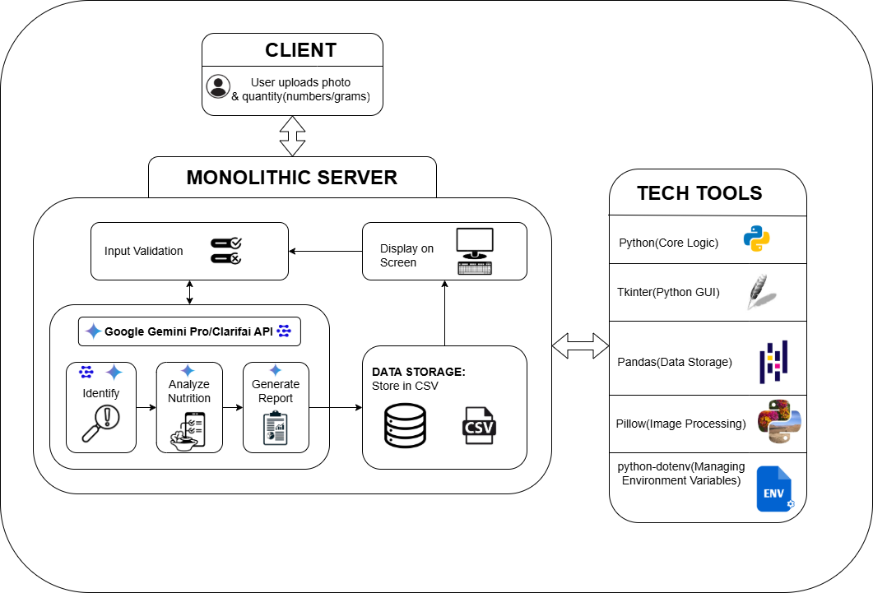
ARCHITECTURE DIAGRAM

Slide 16
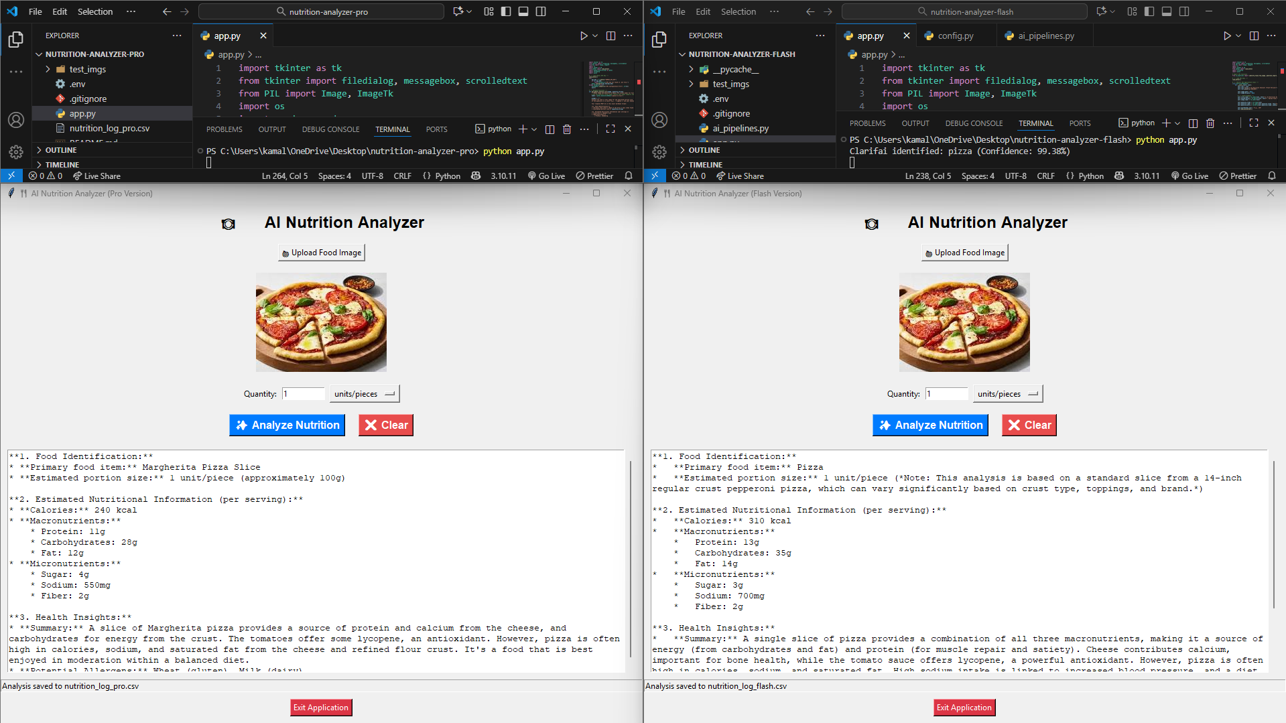
EXECUTION PART

Slide 17
EXPLAIN METHODOLOGY
Data Input & Image Processing: The process begins when a user uploads an image. To ensure the AI model receives a consistent input, the Pillow library is used to open, resize, and convert the image to a standard format (e.g., JPEG). This step minimizes potential errors related to image size or type.
Analysis: Gemini's/with Clarifai’s multimodal capabilities allow it to "see" and "understand" the image content. It identifies distinct food items (e.g., "grilled chicken," "broccoli," "rice"), references its vast knowledge base to estimate nutritional values for the perceived portion sizes, and aggregates this information to compute totals for the entire meal.
Report Generation: The Gemini model doesn't just return numbers. Based on the prompt, it synthesizes the data into a comprehensive and readable report. This includes the total calorie count, percentage breakdowns of macronutrients, and a qualitative judgment on whether the meal is balanced, along with suggestions for healthier alternatives or additions.

Slide 18
SUSTAINABLE DEVELOPMENT GOALS
Target 3.4: By promoting nutritional awareness and helping users track their dietary intake, the tool aids in the prevention and control of non-communicable diseases (NCDs) such as obesity, diabetes, and heart conditions, which are often linked to poor diet.
Promoting Healthy Lifestyles: The application empowers individuals to make informed decisions about their food choices, fostering a proactive approach to health management.
Accessibility: By providing a free and easy-to-use tool, it makes nutritional guidance more accessible to a wider population, reducing inequalities in access to health information.
The project leverages technology to support preventive healthcare, a key component of building sustainable and healthy communities.

Slide 19
REFERENCES
1. Zhou et al., 2021 – Food Recognition Using Deep CNNs.
2. Mekhmoukh et al., 2022 – AI in Personalized Nutrition.
3. Singh et al., 2023 – Nutrient Estimation with Computer Vision.
4. Lee et al., 2023 – Deep-Learning Calorie Estimator.
5. Chen et al., 2024 – Multimodal AI for Food Analysis.
6. Ahmad et al., 2020 – Food Image Segmentation for Calorie Prediction.
7. Kim et al., 2021 – AI-Based Meal Classification for Health Apps.
8. Patel et al., 2022 – Automated Dietary Assessment Tools.

Slide 20
REFERENCES
9. Gupta et al., 2022 – Food Portion Estimation Using Computer Vision.
10. Sharma et al., 2023 – Smart Health Monitoring with AI.
11. Li et al., 2023 – Calorie Estimation via Deep Learning.
12. Wang et al., 2024 – Image-Based Dietary Assessment Systems.
13. Das et al., 2024 – Integrating AI and IoT for Health Analytics.
14. Pandey et al., 2024 – Machine Learning in Nutrition Forecasting.
15. Kumar et al., 2024 – Gemini AI for Multimodal Health Applications.

Slide 21
Thank You

